Slide 1
Custom Liquid Handler Build Guide

Slide 2
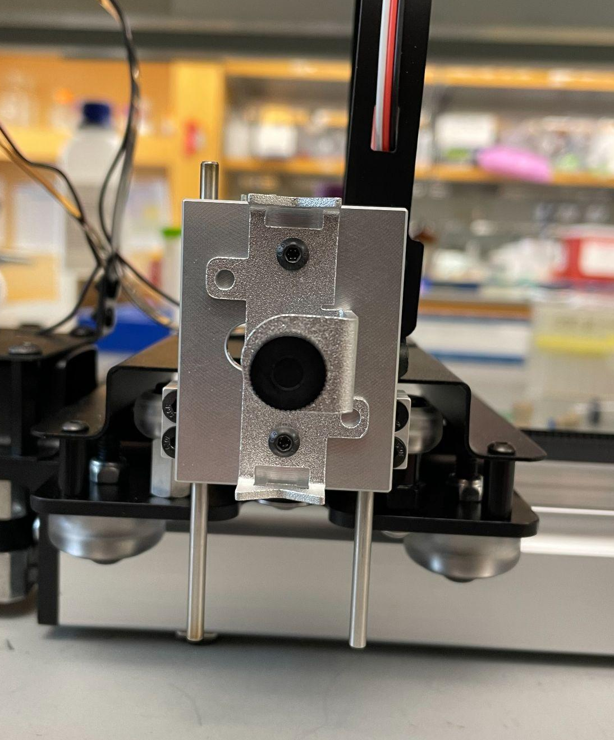
Step 1: Remove the pen holder
Your starting point should look like this:
Begin by removing the pen holder by unscrewing the marked button head screws as shown on the right with the included allen keys
Hold onto the button head screws, which will be used in step 4

Slide 3
Step 2:
Lowering the guide pins
Step 2.1: With carriage removal
Step 2.2:

Slide 4
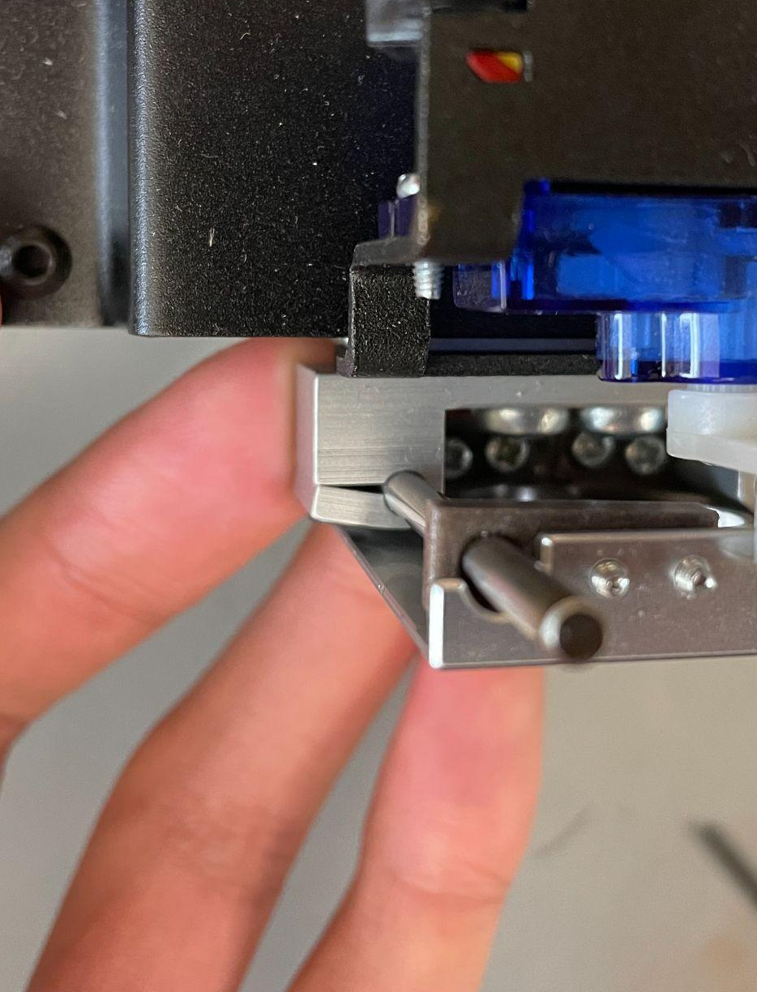
Step 2.1.1: Unscrew the carriage
Looking from the top of the carriage, remove the bottom four screws as indicated in the image to the right.
Be sure to be cognizant of which piece goes on which side they are removed from as they are side dependent and will produce resistance if reattached incorrectly.

Slide 5
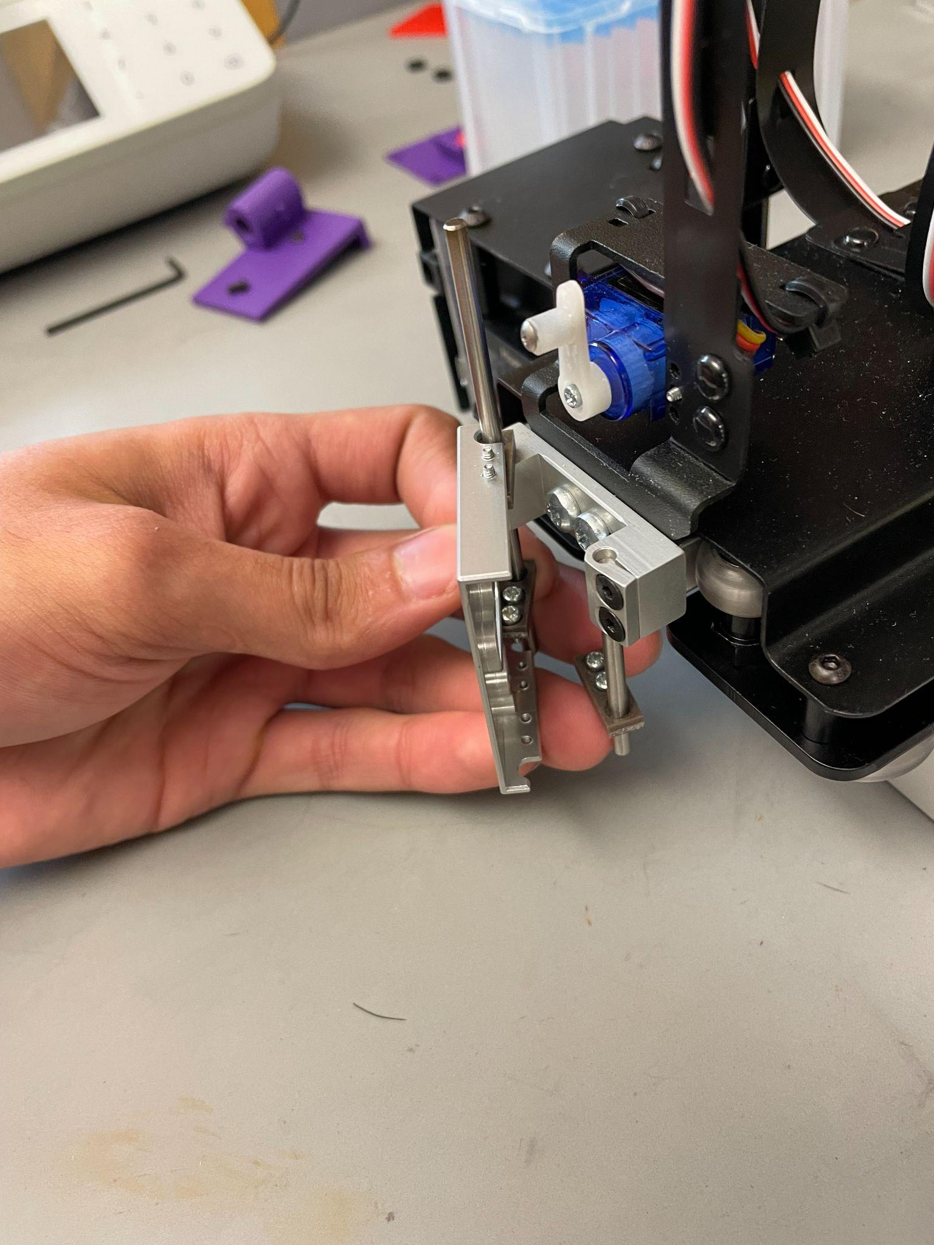
Step 2.1.2: Remove the carriage
Rotate the carriage outwards to clear the servo lever. You might need to loosen the screws holding the top brown guide piece.
Then you can tilt the carriage up and slide it off from the top.

Slide 6
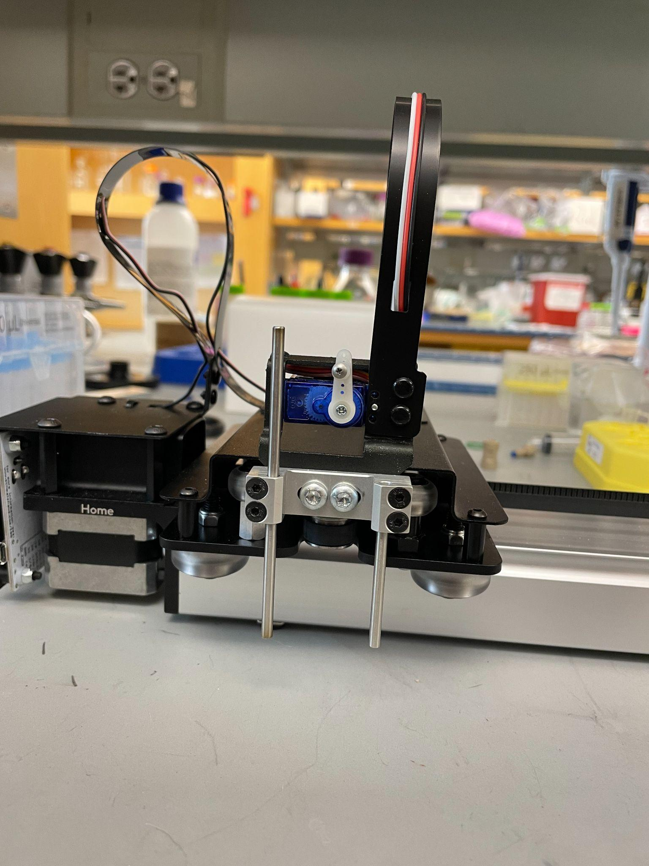
Step 2.1.3: Loosen the guide pin clamps
Loosen the 4 screws that clamp down on the guide pins. Make sure to insert allen key fully as to not strip the screw

Slide 7
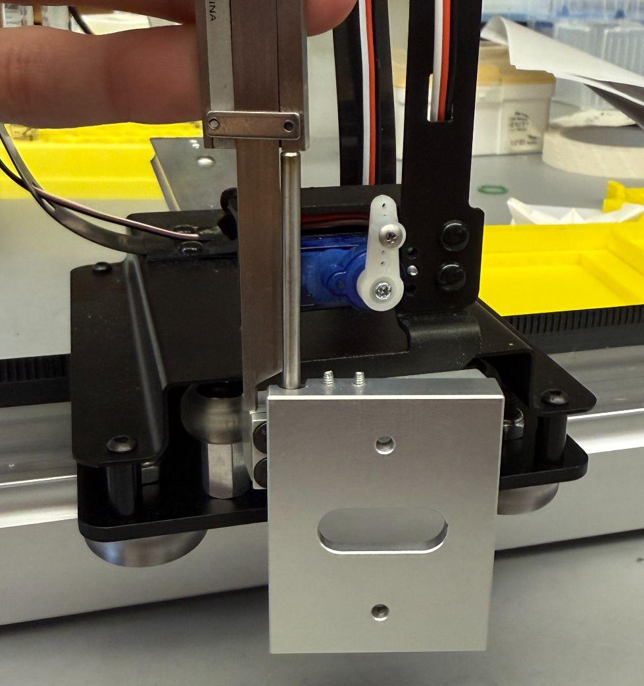
Step 2.1.4: Adjust guide pin height
Now set the top height of the longest bar to a length of 1.7in from the top of the guide pin clamp, as indicated in the image
Then adjust the small guide pin to match the bottom height of the larger guide pin
Tighten the screws to hold the guide pins in place

Slide 8
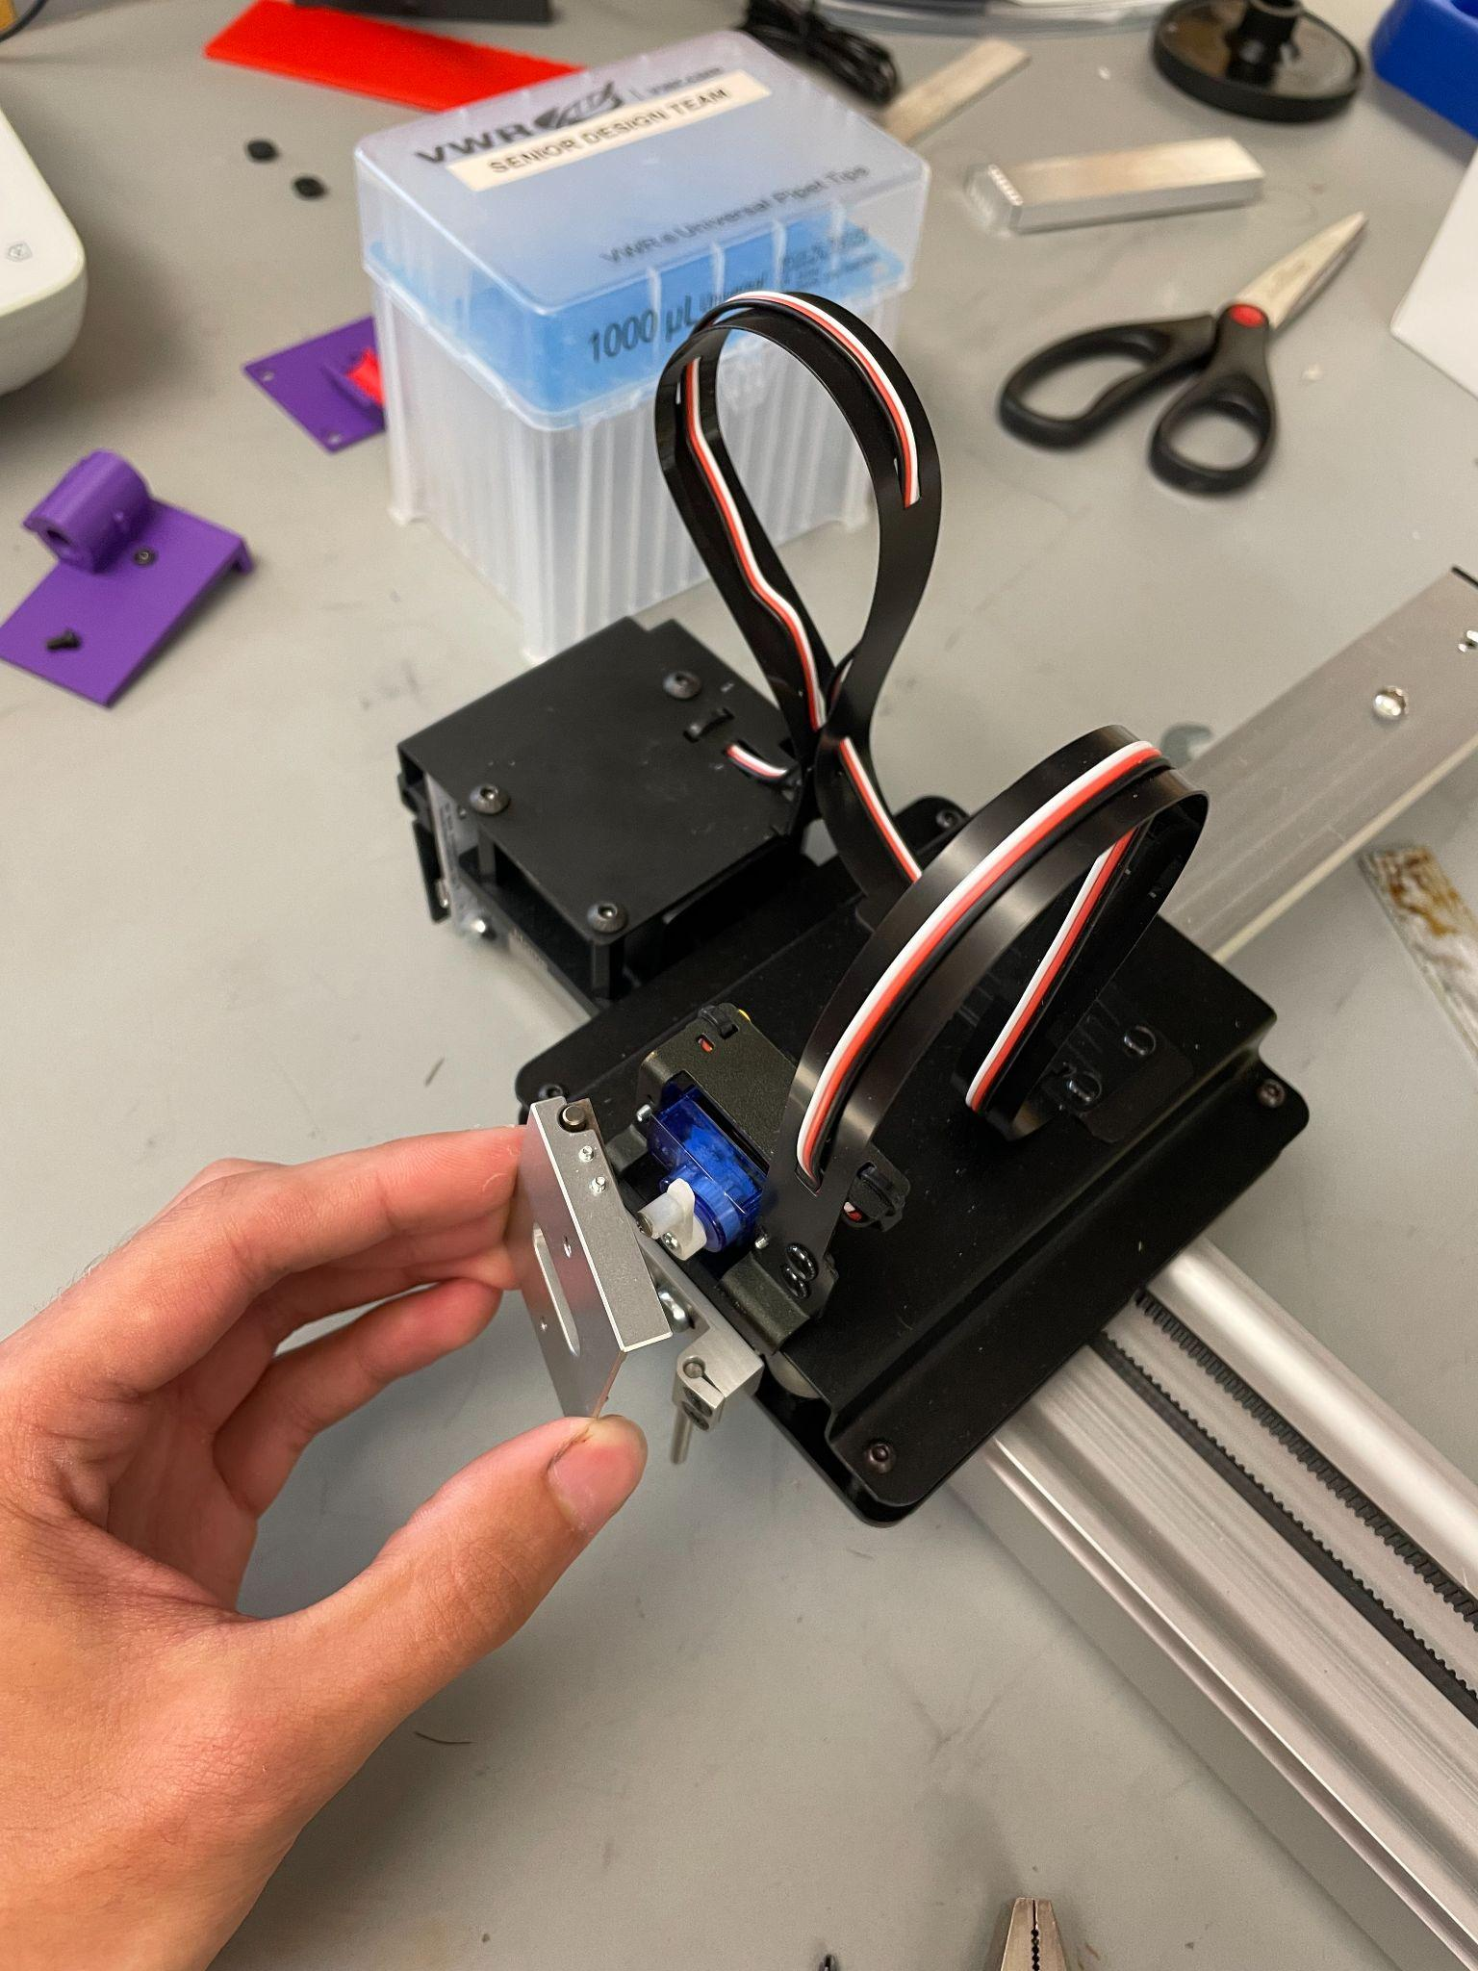
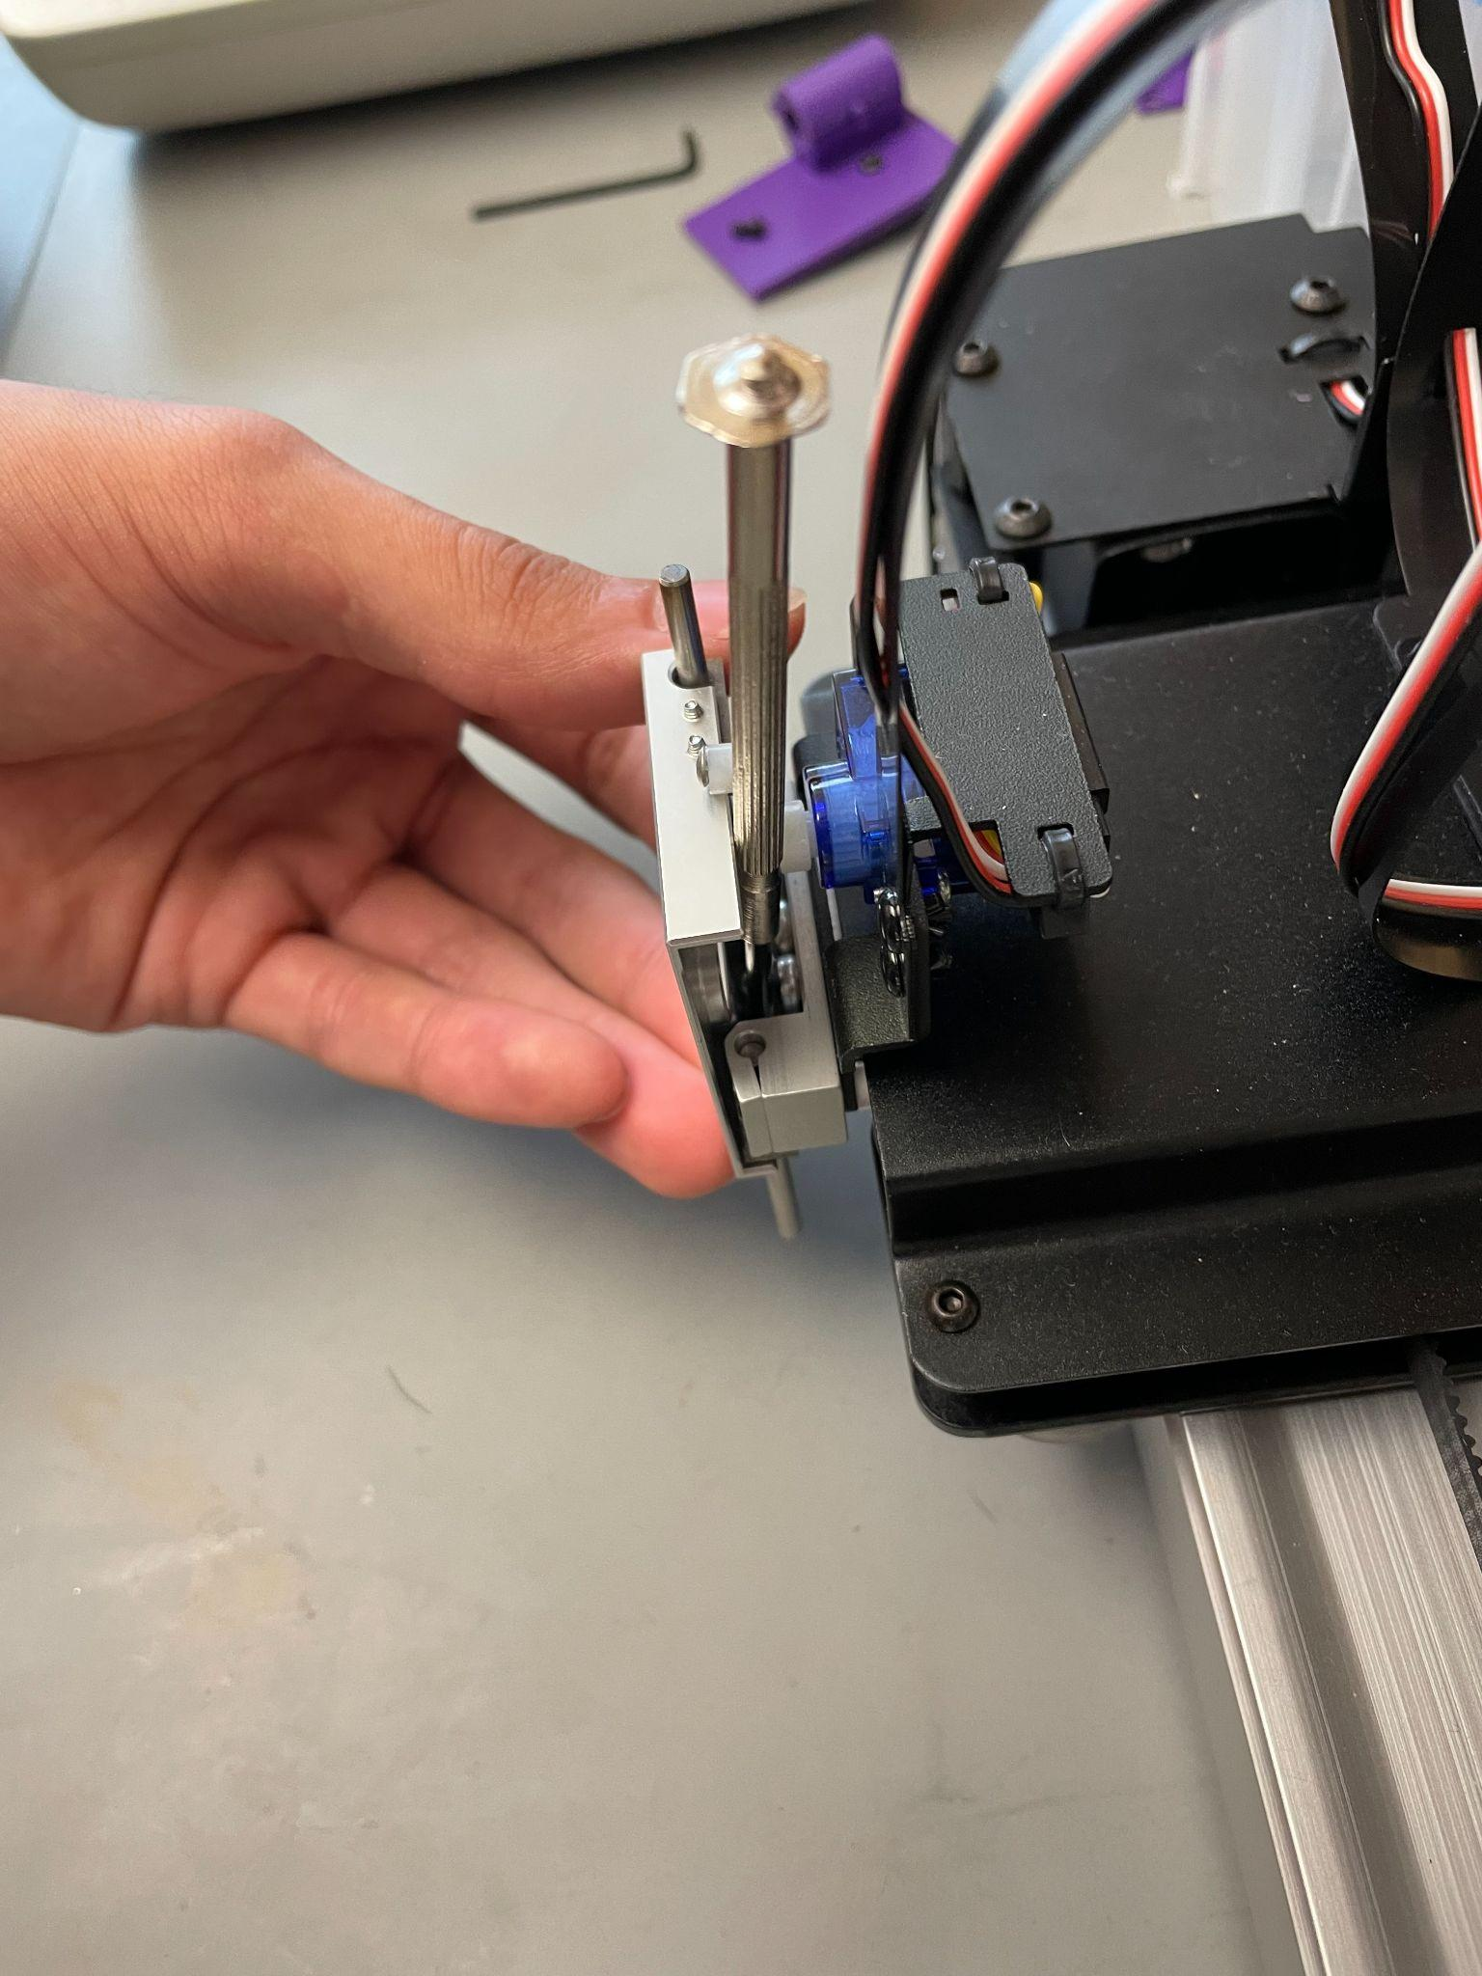
Step 2.1.5: Install carriage
Fig. 1
Begin by inserting the top of the carriage by tilting as seen in the (Fig 1), then make sure the top lip goes BELOW the servo lever.
Then place the brown guides you removed in step 2.1.1, and screw them in as seen in (Fig 2).
Ensure smooth movement up and down, you might need to adjust the guides by loosening the screws.
Fig. 2

Slide 9
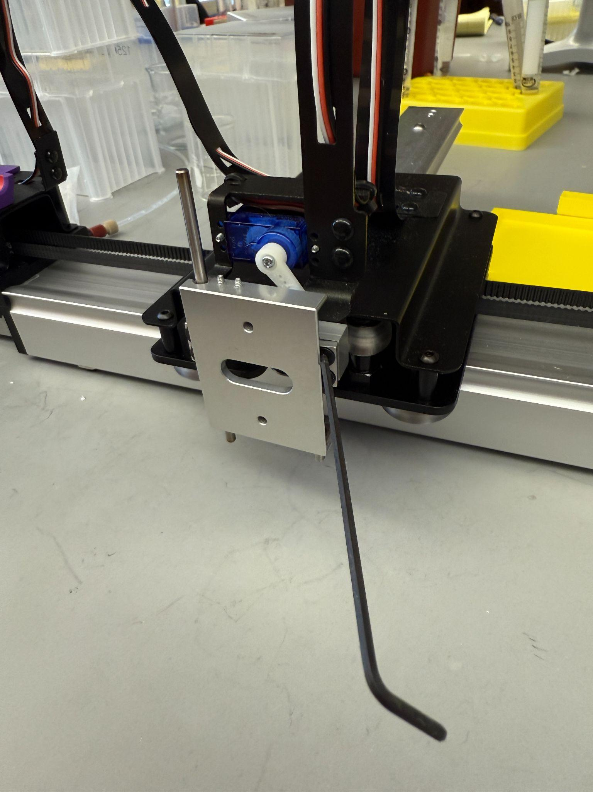
Step 2.2.1: Loosen the guide pin clamps
Loosen the 4 screws that clamp down on the guide pins. Manually move the servo lever down to the lowest position so you can freely move the carriage up and down.
Ensure the ball end of the allen key is inserted fully into the screw, otherwise it will strip.

Slide 10
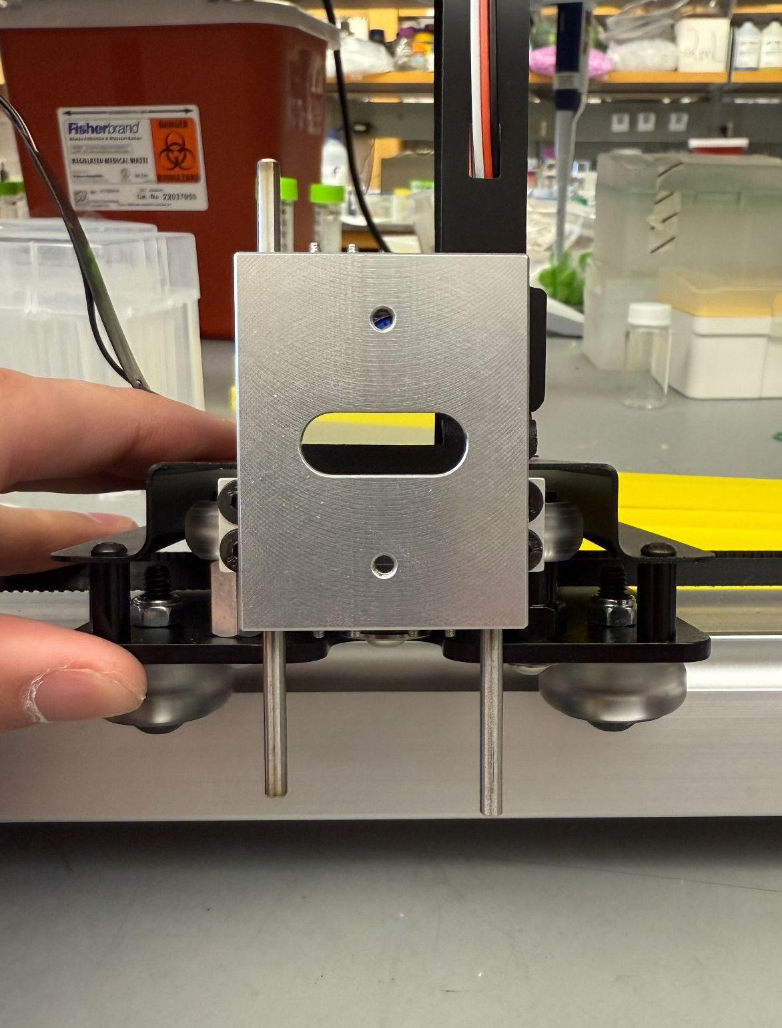
Step 2.2.2: Remove the small guide pin
Now remove the small guide pin by sliding it out from underneath.
You can then tilt the carriage out to move it below the servo lever

Slide 11
Step 2.2.3: Adjust guide pin height
Now set the top height of the longest bar to a length of 1.7in from the top of the guide pin clamp
Then install the smaller guide pin, and match the bottom height of the larger guide pin
Tighten the screws to hold the guide pins in place, as long as the carriage is on

Slide 12
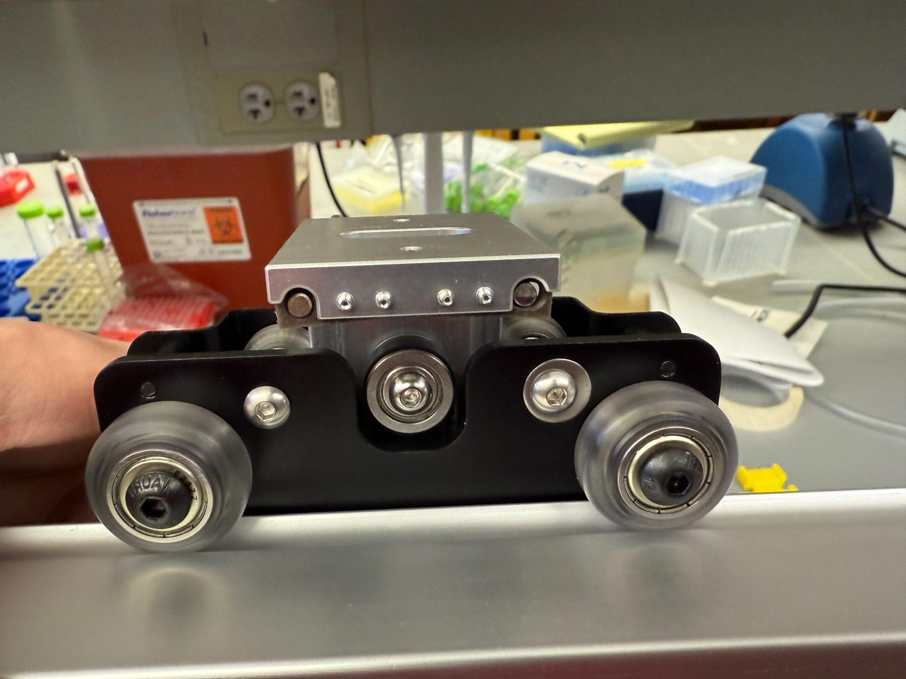
Step 2.2.4: Double check
Ensure the bottom end of the pin does not protrude below the carriage, and is within the brown “bushings”

Slide 13
Step 3: Adjust the servo lever position
Adjust the screw attached to the servo lever to the fourth hole from the center
4
3
2
1

Slide 14
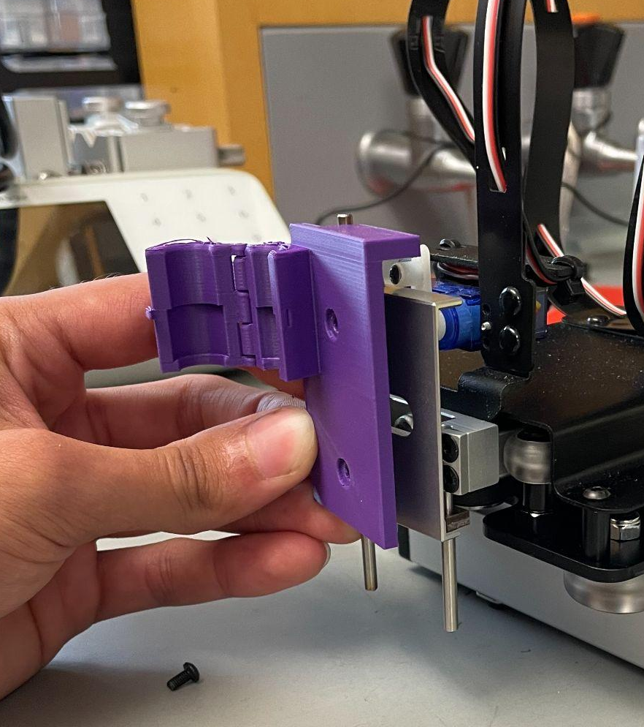
Step 4: Install needle holder
Lift the carriage, and place the needle holder so the servo lever is sandwiched between the aluminum carriage lip, and the 3d printed lip
Use the 2 screws removed from the pen holder to fasten the needle holder

Slide 15
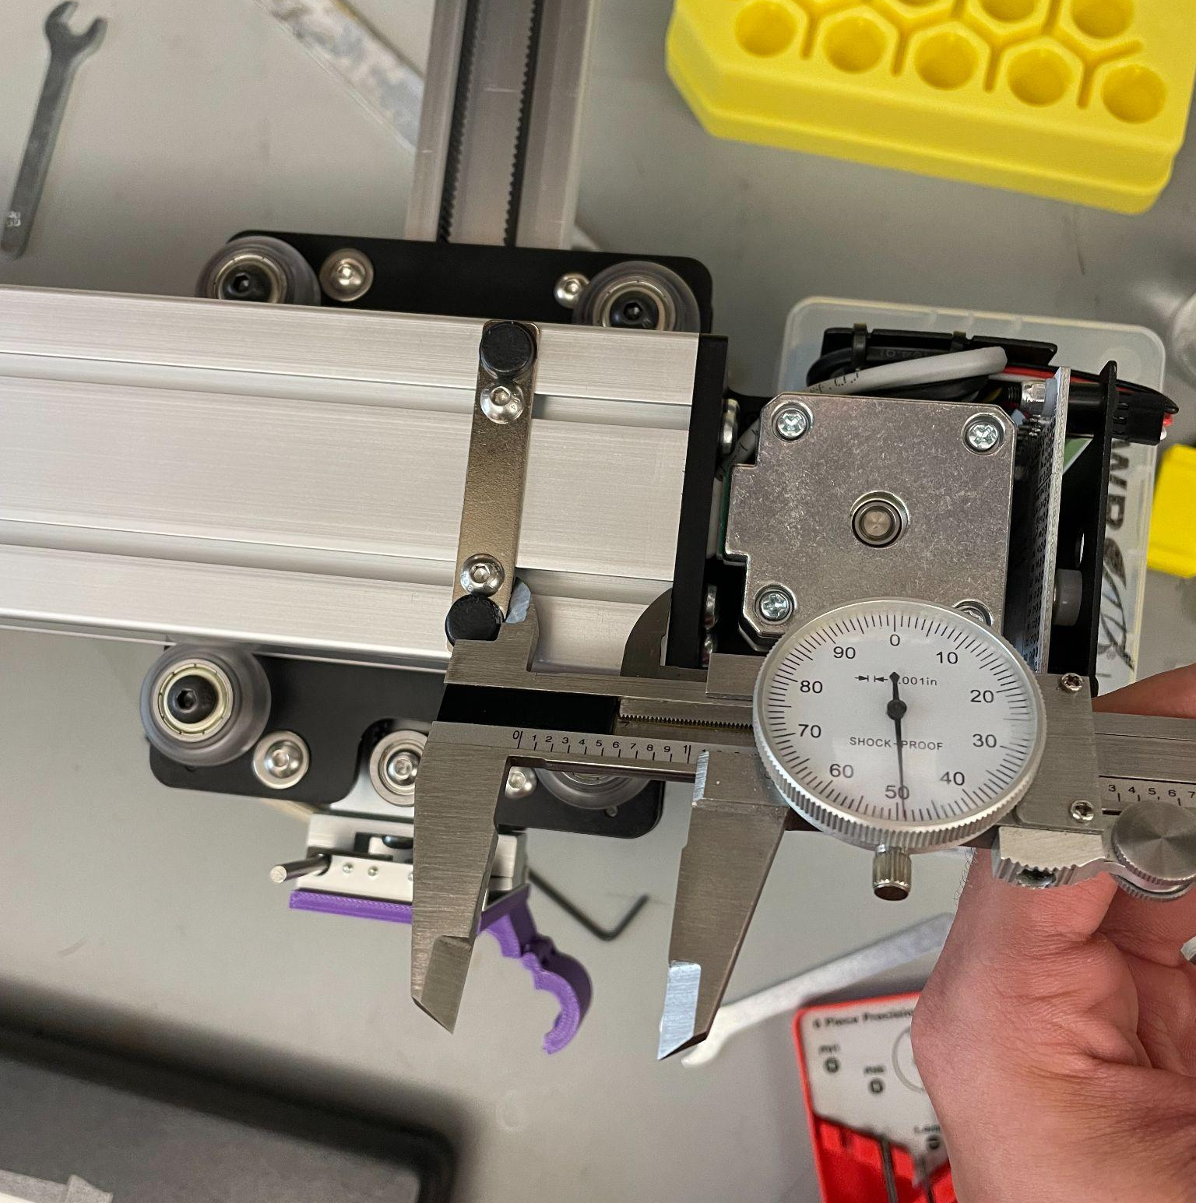
Step 5: Rubber Feet adjustment
Flip the device over. You could use two objects placed underneath the motors on both ends to make it easier to work on.
Unscrew the two button head screws, and move the rubber feet plate to 1.05 inches (26.67mm) from the black endplate.
1.05in

Slide 16
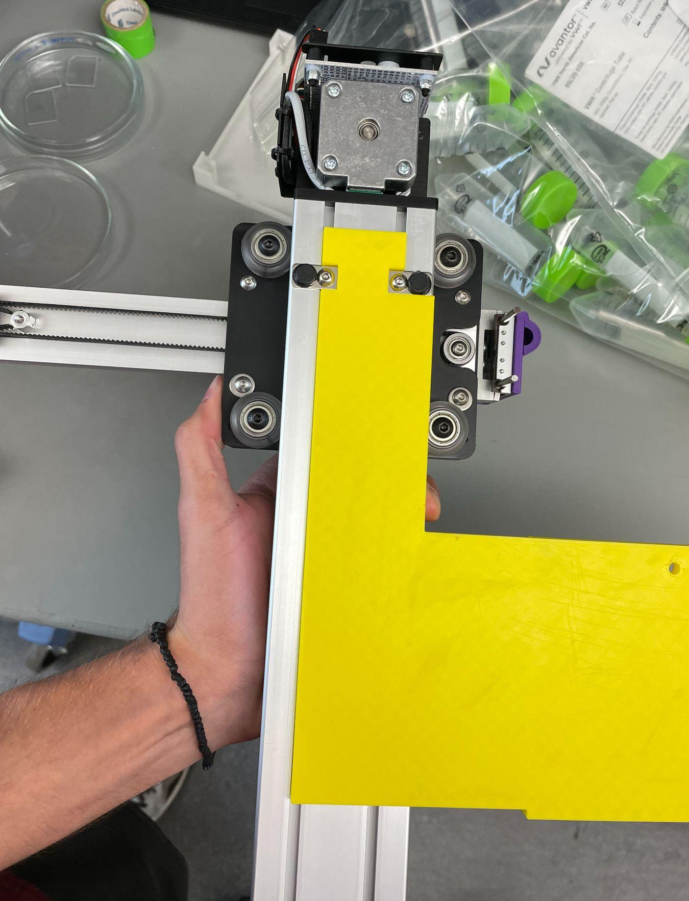
Step 6: Install platform
Press the platform in so the notch lines up with the rubber feet plate, and ensure the two ridges fit in the slots on the underside of the device, as shown in the picture.

Slide 17
Fluidic System Build Guide

Slide 18
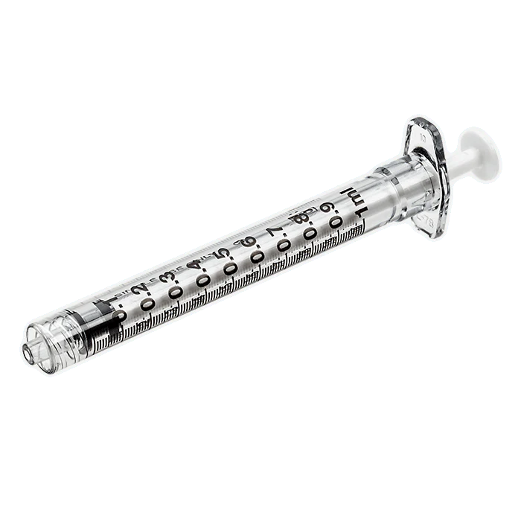
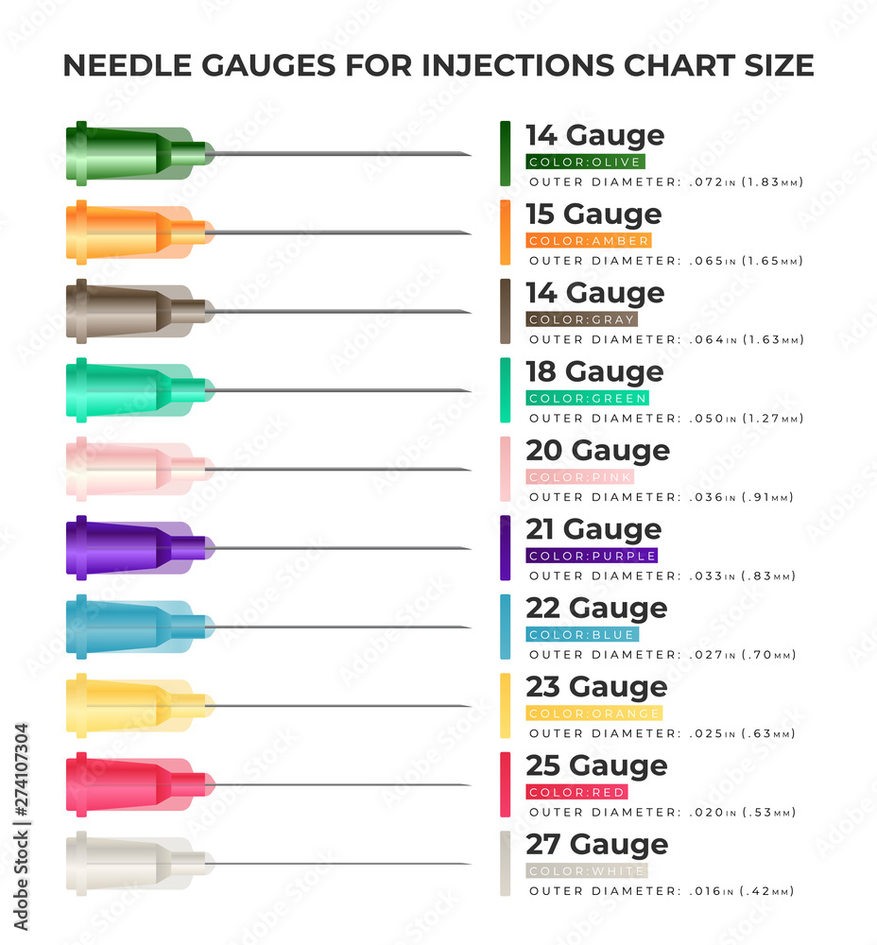
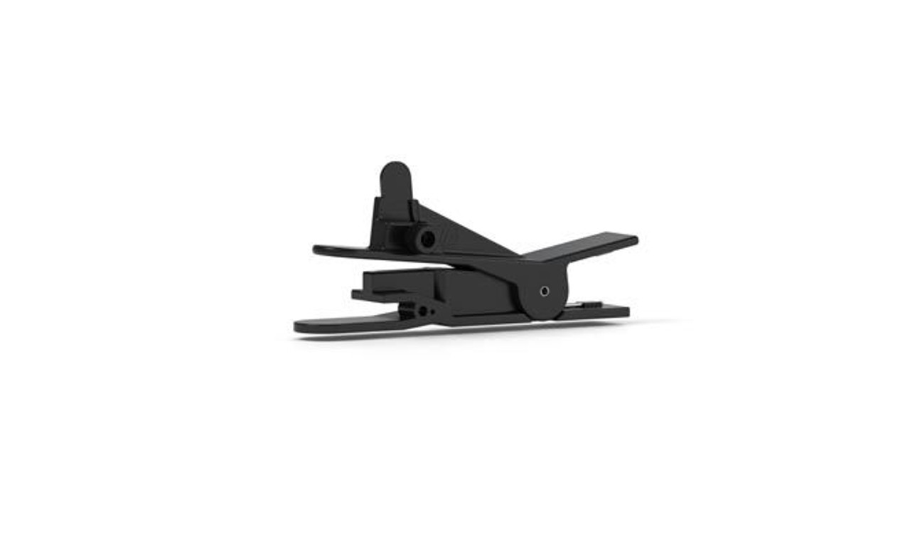
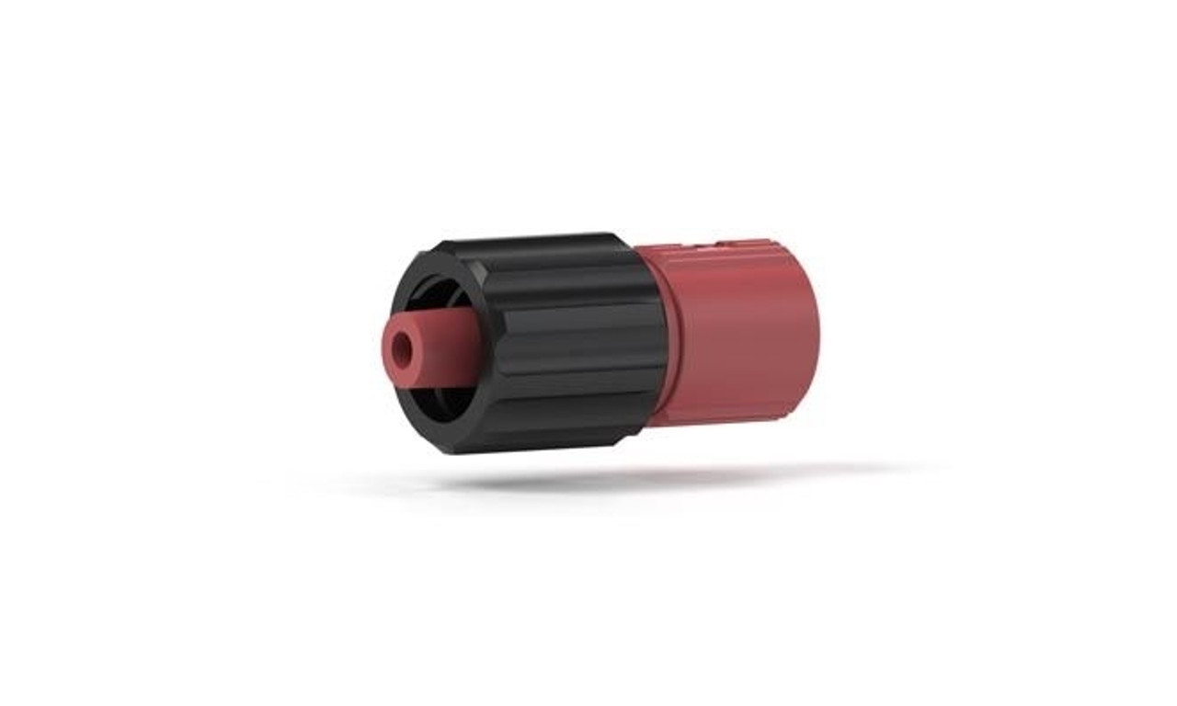
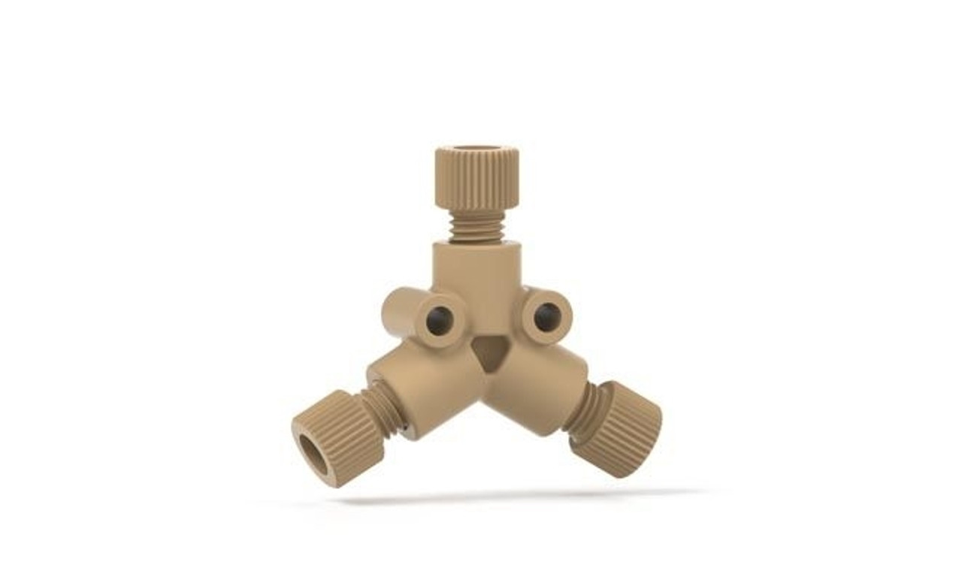
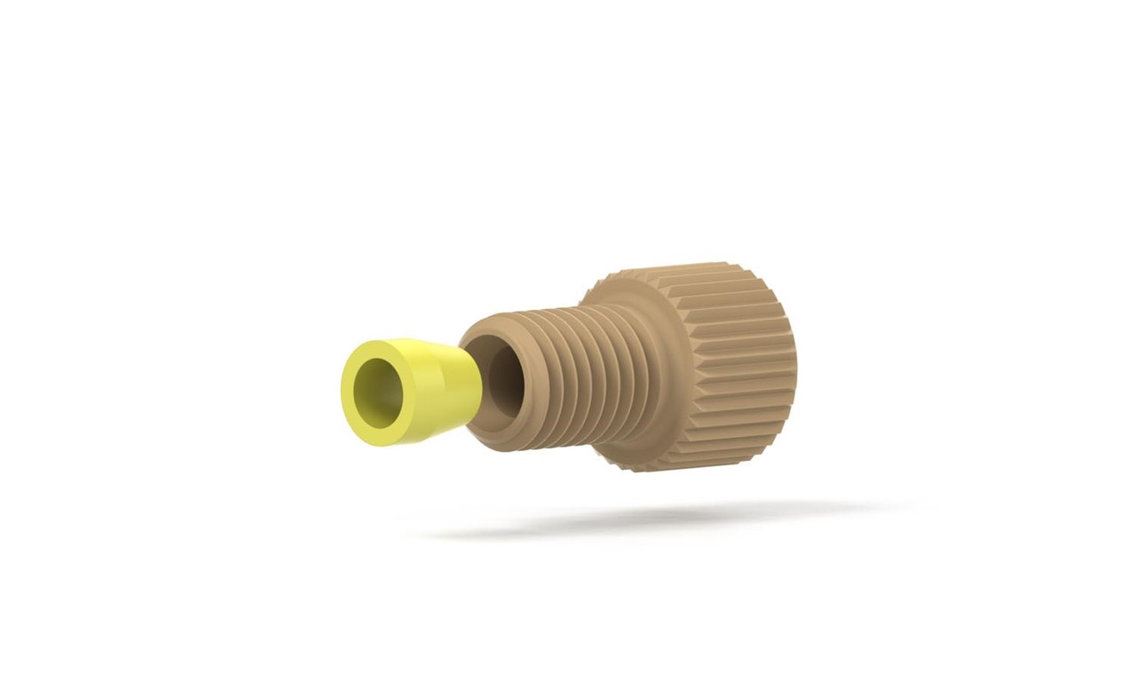
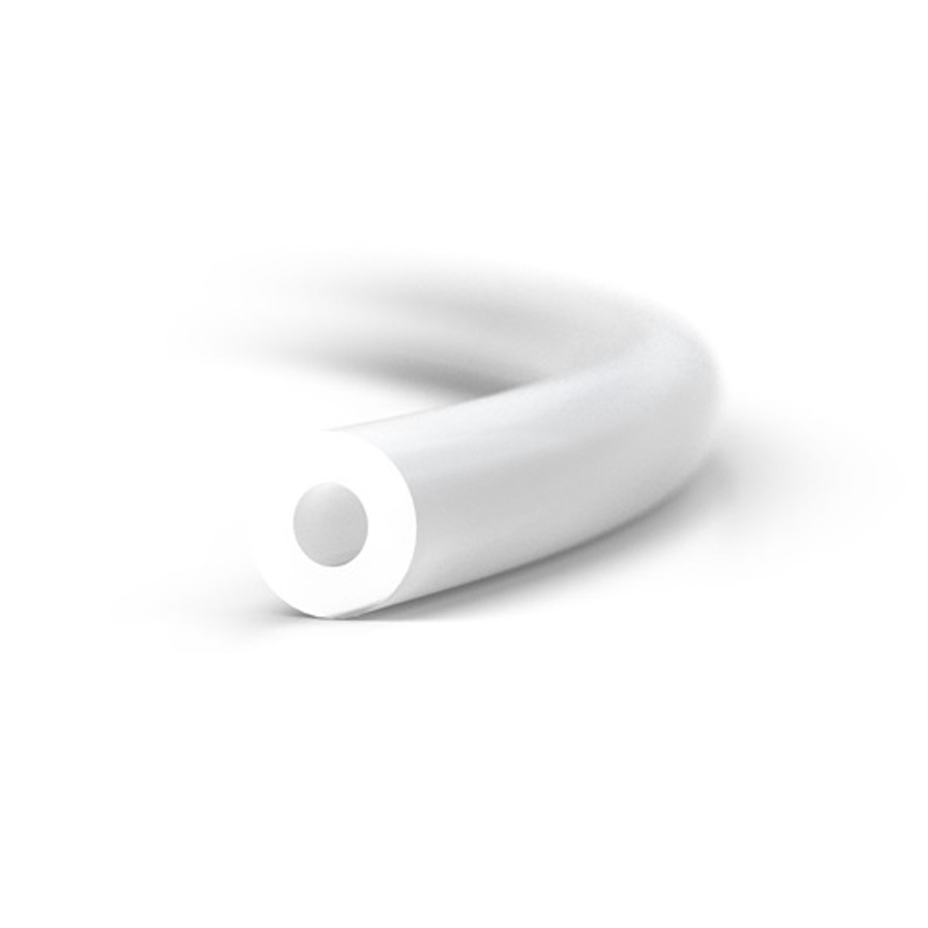
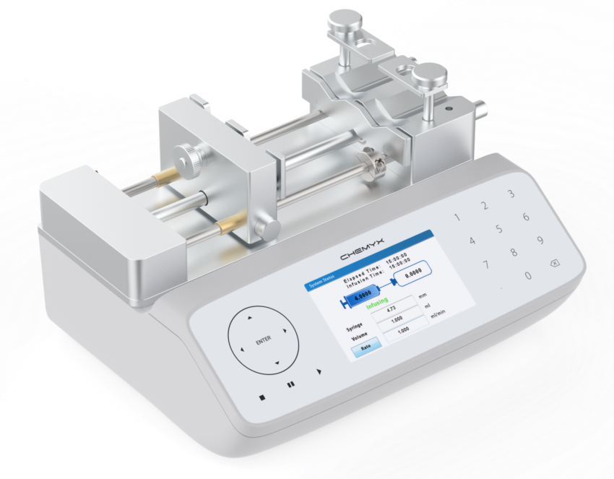
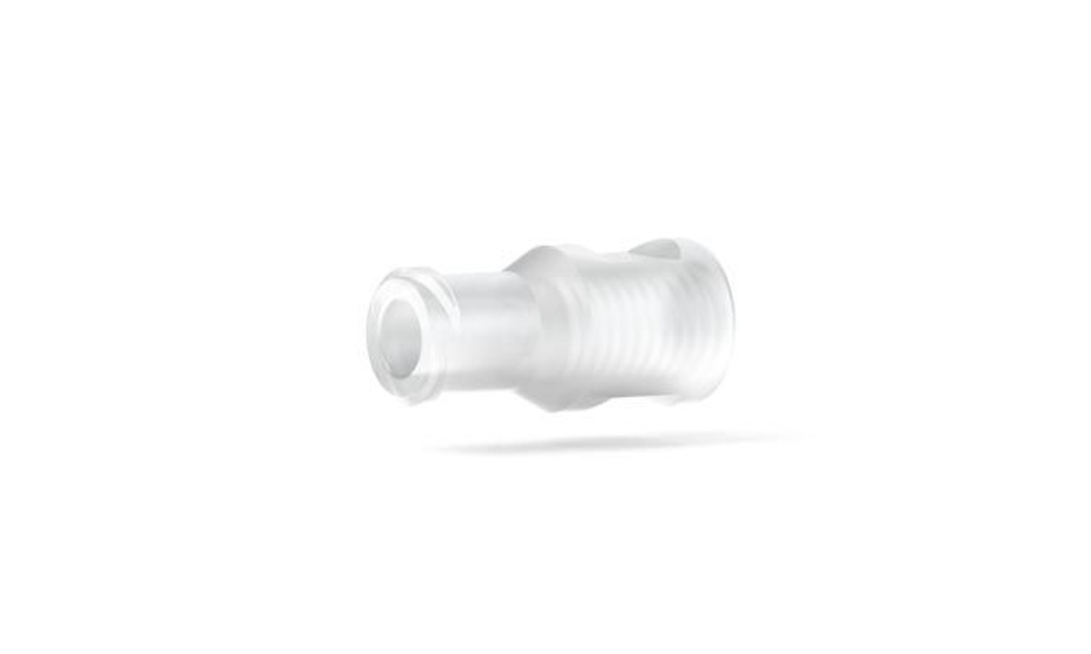
Parts List
40mm 20/22 gauge hypodermic needle
IDEX F-0.25-28/M-Luer (P-655)
IDEX Flngls Sys Short PEEK ⅛ 10pk (XP-335X)
38 in IDEX Tub FEP nat 1/8x.062 x 50ft (1521L)
(2X) IDEX F-Luer/F-Union (P-628)
(2X) BD 1ml syringe Luer-Lok tip
Plastic Tubing Cutter (A-327)
P-514 - PEEK Y Assembly 1/4-28 .060in thru hole
ChemyX Syringe pump Fusion 200x

Slide 19
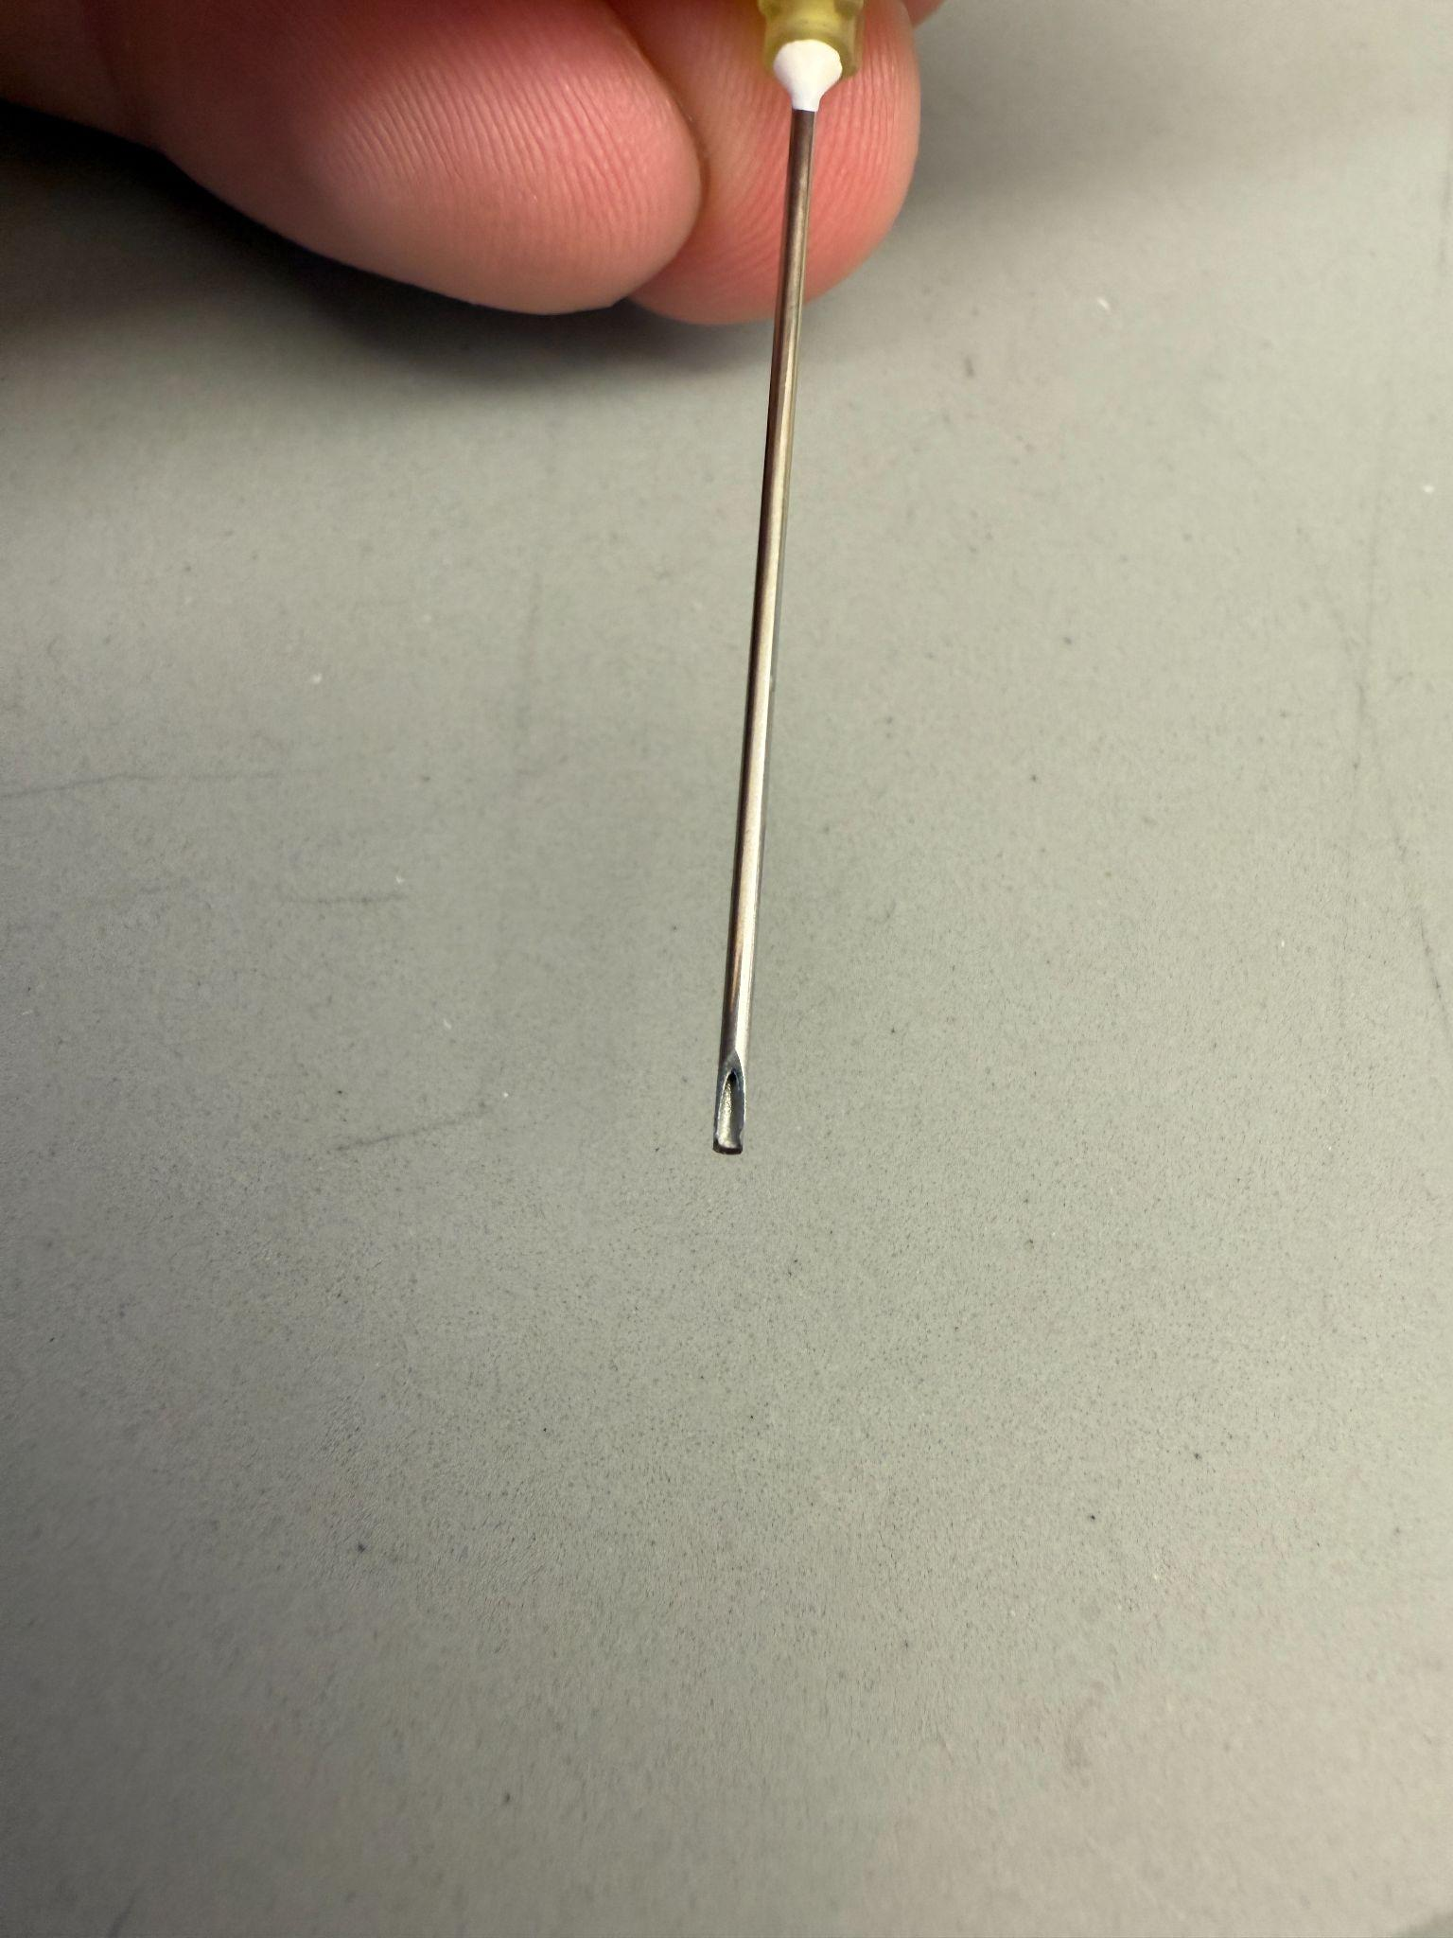
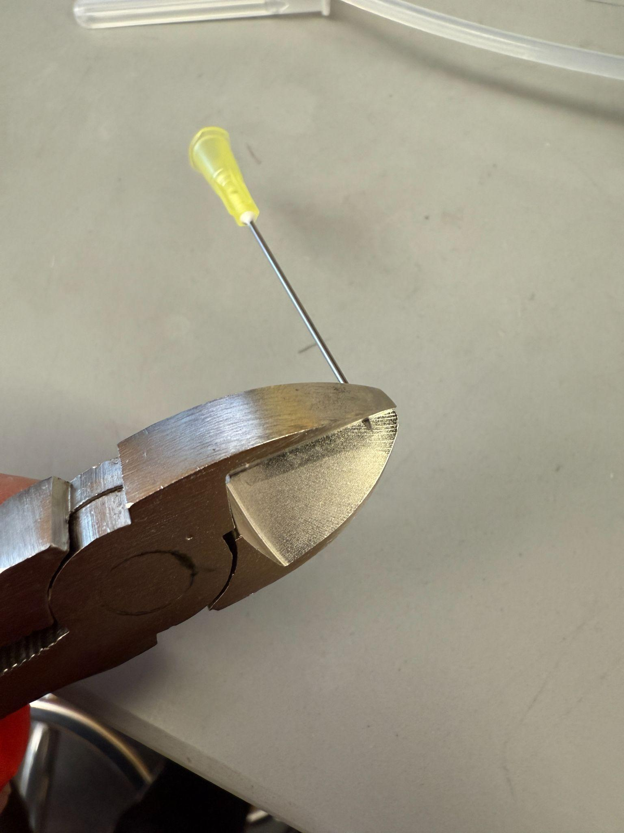
Step 1: Preparation
Snip the end of the hypodermic needle with a pair of side cutters, or other cutting tool
Cut the 1/8th OD tubing to 36 in (91.4 cm) long using a tubing cutter, or a utility knife, making sure to have a flat and perpendicular cut with no burrs
Also cut 2 short pieces of 1/8th OD tubing at 1 inch in length

Slide 20
Step 2: Connect the tubing together

Slide 21
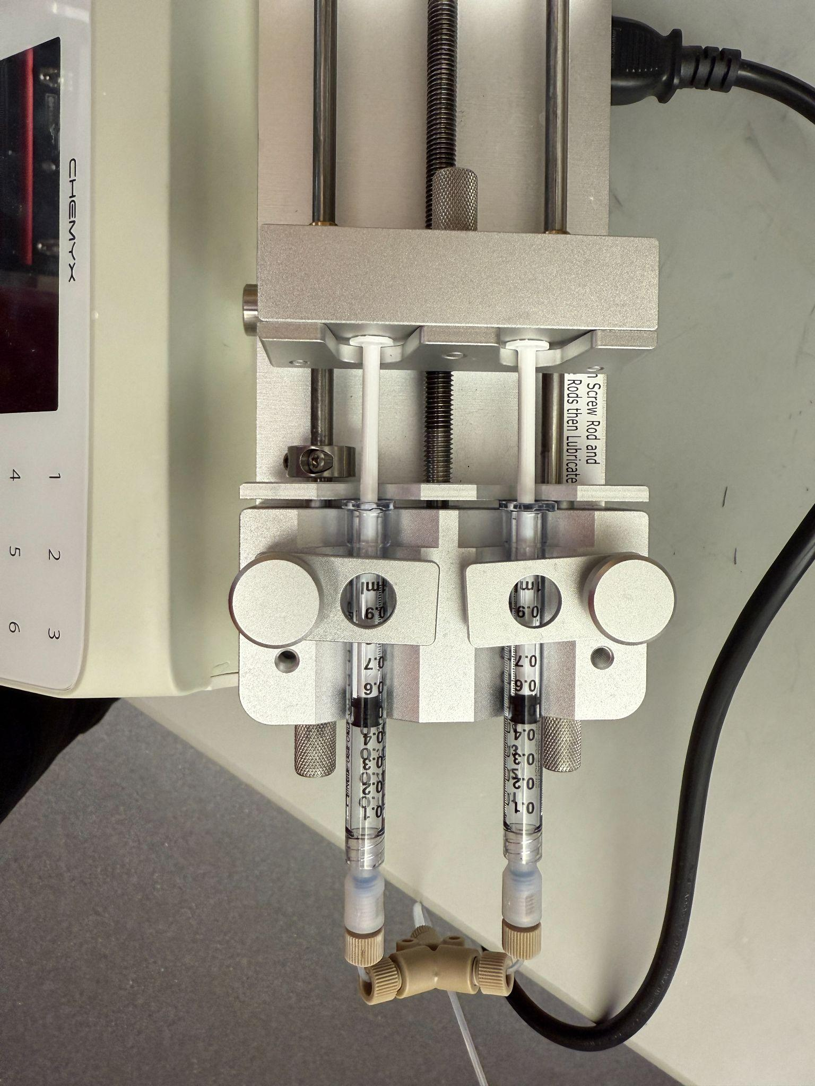
Step 3: Attach syringe to pump
Attach the two syringes to the ChemyX Fusion 200x syringe pump, making sure to clamp down both ends

Slide 22
Step

